Slide 1
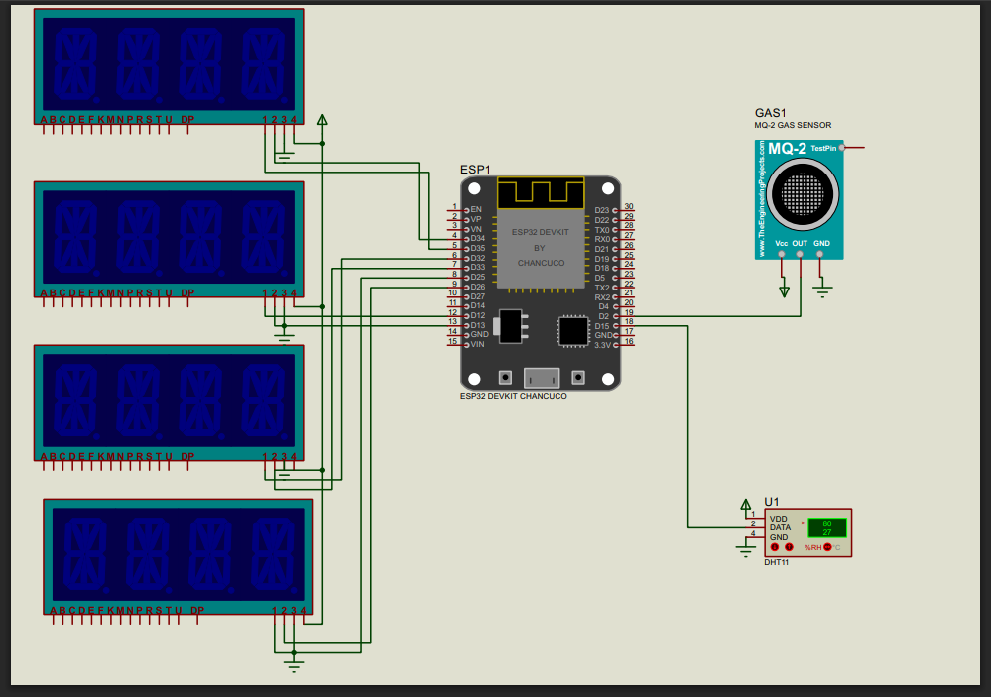
CIRCUIT DIAGRAM

Slide 2
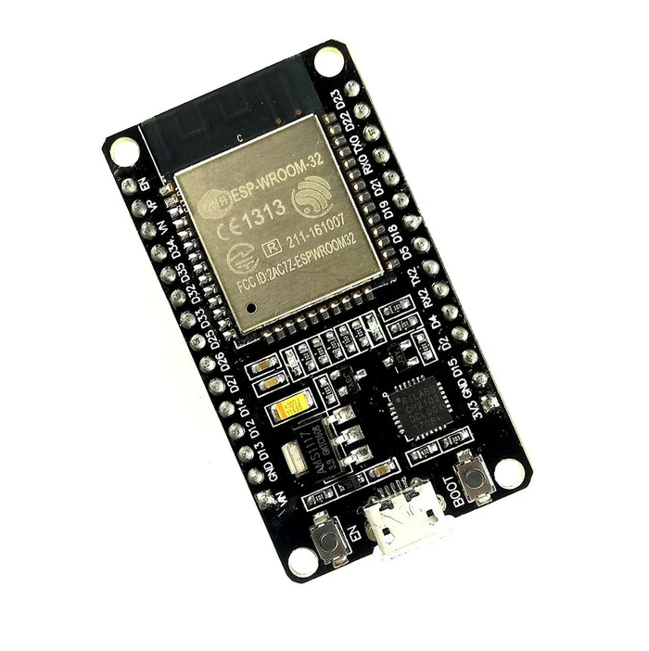
ESP32 MICROCONTROLLER
The NodeMCU ESP32 board is a versatile development platform widely used in IoT (Internet of Things) projects.
It integrates the ESP32 microcontroller, which features dual-core processing, Bluetooth, Wi-Fi connectivity, and ample GPIO pins.
The board supports a variety of programming environments including Arduino IDE and MicroPython, making it accessible for both beginners and experienced developers.

Slide 3
ESP32 FEATURES
NodeMCU based on ESP-WROOM-32 module
30 GPIO Version
ESP32 is a dual-core 32-bit processor with built-in 2.4 GHz Wi-Fi and Bluetooth
4 MByte flash memory
520 KByte SRAM
2.2 to 3.6V Operating voltage range
In breadboard-friendly breakout
USB micro B for power and Serial communication used to load the program and serial debugging too

Slide 4
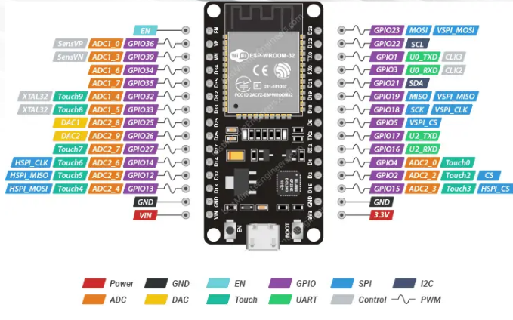
ESP32 PINOUT

Slide 5
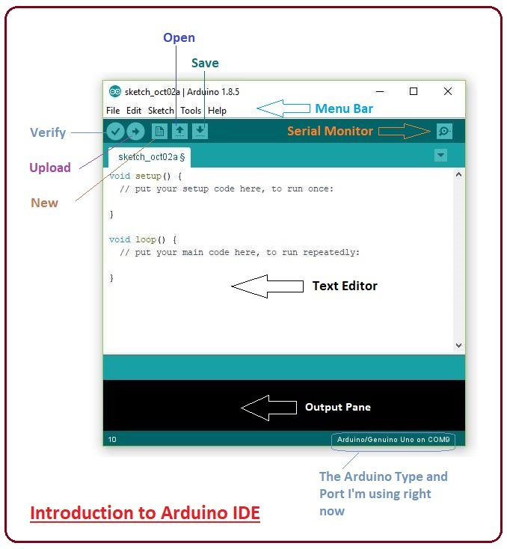
ARDUINO IDE PROGRAMMING SOFTWARE
The Arduino Integrated Development Environment (IDE) is a cross-platform application (for Windows, macOS, Linux) that is written in functions from C and C++. It is used to write and upload programs to Arduino compatible boards, but also, with the help of third-party cores, other vendor development boards.
Arduino code is written in C++ with an addition of special methods and functions, which we'll mention later on. C++ is a human-readable programming language. When you create a 'sketch' (the name given to Arduino code files), it is processed and compiled to machine language.

